Slide 1
A/B Testing and Randomized Experiments

Slide 2
Agenda
Origin of A/B testing and why do we use it?
A/B testing examples
Excel Worksheets –
Pre-campaign Sample Size Calculation
Post-campaign measurement of Lift and Significance test
Adobe Target – Test Scenarios
2

Slide 3
Origin of Randomized Experiments¹
Psychologists from the late 19th century, see Leigh (2018) – on lifted weights
Charles Sander Peirce and Joseph Jastrow
Statisticians from the early 20th century – in agriculture
Ronald A Fisher and Jerzy Neyman
Practical business applications started over 30 years ago
Capital One – credit card, see Davenport (2009)
PI
All other industries
“A/B Testing is a Randomized Experiment with two variants, A and B. It includes application of statistical hypothesis testing.” From Wikipedia
¹ While randomized experiments are now known to begin in the late 19th century, the first ever recorded controlled experiment (comparing treatment vs. control) is over 2,600 years old: 6th BCE recorded in the Book of Daniel, see Pearl (2018) and Angrist & Pischke (2015).

Slide 4
Why Randomized Experiment?
4
Ensures that the characteristics of the treatment and control groups are the same prior to the design
Balanced in both observable and unobservable characteristics
Most popular randomized experiment is A/B Testing, where only two options are compared - treatment vs. control, challenger vs. champion, or simply A vs. B
When more than two options are compared, it is called A/B/n Testing

Slide 5
Shoe Example
Target Group
Treatment
Focus on Durability and all weather feature
Control
Emphasize on multi-functional feature for business & leisure
Test two promotional messages
Target Group
Treatment Discounted price $69.99 - $99.99
Control
Current price range $89.99 - $119.99
Test the impact of discounted pricing
5

Slide 6
Shoe Example – Can We Combine them?
Target Group
Treatment
1) Focus on Durability and all weather feature +
2) discounted price
Control
1) Emphasize on multi-functional feature for business & leisure +
2) current price
Test combination of discounted pricing & promotional messages
Any problem with this?
6

Slide 7
Shoe Example – All Possibilities: Full Factorial
Target Group
Treatment: Focus on Durability and all weather feature
Control: Emphasize on multi-functional feature for business & leisure
Discounted Price (A)
Current Price (B)
Discounted Price (C)
Current Price (D)
Test combination of discounted pricing & promotional messages
Promotional
Message
Pricing
A+B vs C+D: Test effect of different promotional messages
A+C vs B+D: Test effect of discounted price
A vs B or C vs D: Test effect of discounted price within promotional messages
More Attributes can be tested using Factorial Design (Full Factorial or Fractional Factorial), aka Multivariate Testing (MVT)
7

Slide 8
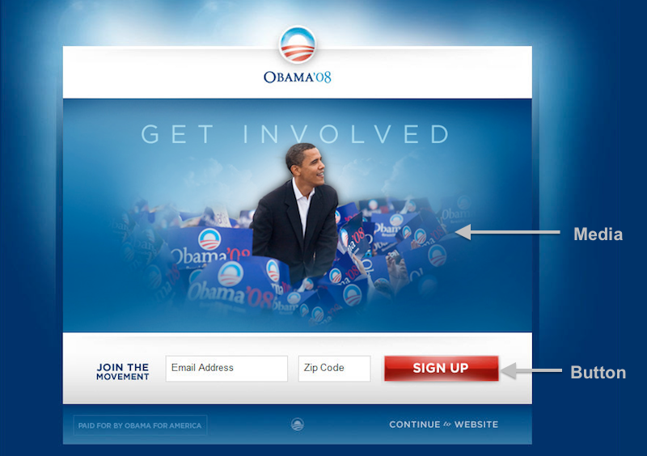
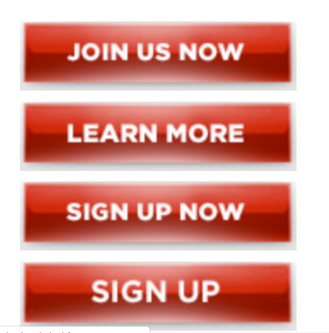
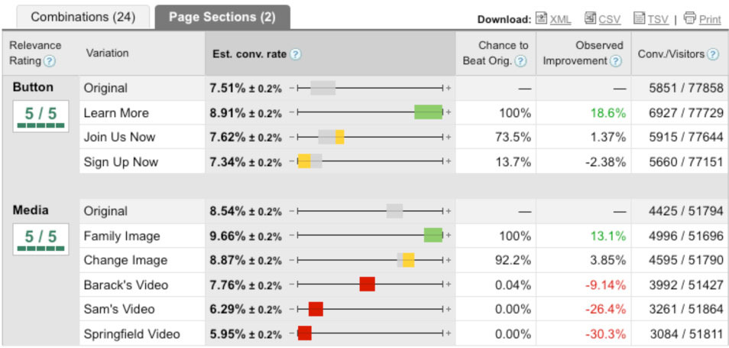
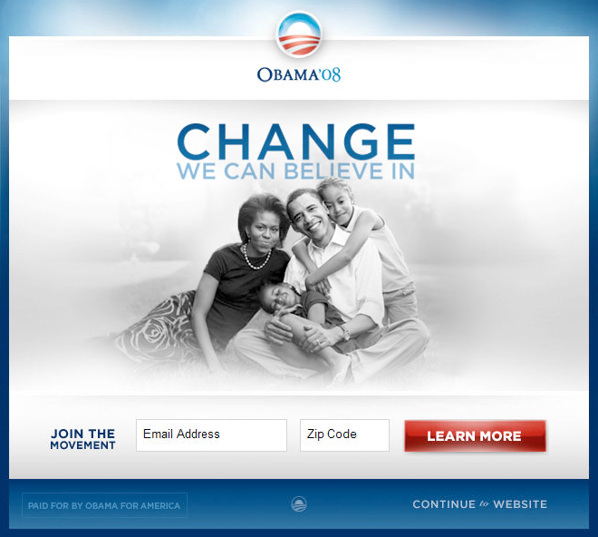
Example: Presidential Election
4x6 = 24 combinations (full factorial)
Source: https://blog.optimizely.com/2010/11/29/how-obama-raised-60-million-by-running-a-simple-experiment/
8

Slide 9
Case Study: Pre-Campaign Sample Size Determination
Pre – A/B test Decision:
Product Manager Sarah is planning to have an A/B test on a product web page for enrollment:
Control: legacy page
Treatment: legacy page + an enrollment demo video
Goal: test if the treatment drives a higher CTR (click thru rate)
She is not sure of the success of the new page, so wants to move cautiously as adverse CTR can impact enrollment
Current relevant web page traffic: 4,000 per day and current legacy page CTR: 0.8%
Expects the treatment page CTR: ~1.0%
Help her design the Test: Determine # days she needs to run to achieve a statistically significant result at 5% significance level
9

Slide 10
Pre-Campaign Sample Size Determination: Statistical Terminology
Null hypothesis, H₀: Treatment = Control
Alternative hypothesis, H₁: Treatment > Control
 | Do Not Reject (or Accept) H₀ | Reject H₀
H₀ is true | Correct Decision | Type I error (α)
H₁ is true | Type II error (β) | Correct Decision
Significance level
Probability of rejecting H₀ if H₁ is true = Power
10

Slide 11
Case Study: Post-Campaign Statistical Test
Post – A/B Test Decision:
Product Manager Sarah gets the results after 17 days
Control page has 51,000 visits with 403 clicks (CTR = 0.79%)
Treatment page has 17,000 pages with 162 clicks (CTR = 0.95%)
Sarah is contemplating whether she can draw a conclusion whether treatment is better than control
Help Sarah decide in calculating lift and significance level of A/B test:
Is the treatment page better than control?
Can she ask them to switch 100% to treatment right away?
Is there any advantage in running the test for a few more days?
11

Slide 12
Excel Template to Decide Sample Size and Significance Test
Sign. Level = chance of detecting a difference (rejecting H₀) if such difference does not exist (H₀ is true)
Power = chance of detecting a difference (rejecting H₀) if such difference truly exists (H₁ is true)
Significant if p-value < significance level
P-value = chance that the data would be at least as extreme as observed if there is no difference (i.e., H₀ is true)
12

Slide 13
Summary
Randomized Experiment is a VERY powerful, popular, and practical tool
Does require background and experience to run, despite its simple look
Professionals from Data & Analytics are here to help:
If AI/DS models are involved, partner with the WI AI team (Victor Lo, Theresa Mazzio)
If Adobe Target is used, partner with Digital Analytics (Siba Kar)
For all others, please partner with Business Analysis (Sean Liddy)
Many analysts are embedded in business squads
Central team of analysts
13

Slide 14
References
Conceptual or Methodological but Non-technical References
Anderson, Eric T., and Duncan Simester (2011), “A Step-by-Step Guide to Smart Business Experiments,” Harvard Business Review, available here.
Ash, Tim, Rich Page, and Mura Ginty (2012), Landing Page Optimization: The Definitive Guide to Testing and Tuning for Conversions, 2nd edition, Sybex.
Banerjee, Abhijit and Esther Duflo (2012), Poor Economics: A Radical Rethinking of the Way to Fight Global Poverty, PublicAffairs.
Davenport, Thomas (2009), “How to Design Smart Business Experiments,” Harvard Business Review, available here.
Gerber, Alan S. and Donald P. Green (2012), Field Experiments: Design, Analysis, and Interpretation, Norton.
Glennerster, Rachel and Kudzai Takavarasha (2013), Running Randomized Evaluations: A Practical Guide, Princeton.
Leigh, Andrew (2018), Randomistas: How Radical Researchers are Changing Our World, Yale.
Manzi, Jim (2012), Uncontrolled: The Surprising Payoff of Trial-and-Error for Business, Politics, and Society, Basic Books.
McFarland, Colin (2013), Experiment! Website Conversion Rate Optimization with A/B and Multivariate Testing, New Riders.
Pearl, Judea (2018), The Book of Why: The New Science of Cause and Effect, Basic Books.
Wendel, Stephen (2013), Designing for Behavioral Change: Applying Psychology and Behavioral Economics, O’Reilly.
Technical References
Angrist, Joshua and Jorn-Steffen Pischke (2015), Mastering Metrics: The Path from Cause to Effect, Princeton.
Box, George E.P., William G. Hunter, and J. Stuart Hunter (1978), Statistics for Experimenters: An Introduction to Design, Data Analysis, and Model Building, Wiley.
Ledolter, Johannes and Arthur J. Swersey (2007), Testing 1-2-3: Experimental Design with Applications in Marketing and Service Operations, Stanford.
Montgomery, Douglas C. (1991), Design and Analysis of Experiments, 3rd edition, Wiley.
14
Notes:
Presenter = VL

Slide 15
Appendix

Slide 16
What to Consider When Designing an Experiment
WHO
Who is your target audience
WHAT
What is your call-to-action (CTA)
What are the treatments, e.g., message, incentive, offer, product
HOW
What channels would you test, e.g., call, email, online
Once you have some ideas of the above, draw a design diagram and determine the sample size
16

Slide 17
How to Randomize into A and B?
Flip a coin
Put all the names in a hat, and randomly draw them
Hit the “Rand” button on your cell phone calculator, and assign to A if <0.5 and B if >0.5
Use RAND() in Excel
Use tools such as Adobe Target
17

Slide 18
Common Experiments that You May Already be Part Of
Online Ads
Emails
Amazon
Netflix
Credit Cards
Clinical Trials
18

Slide 19
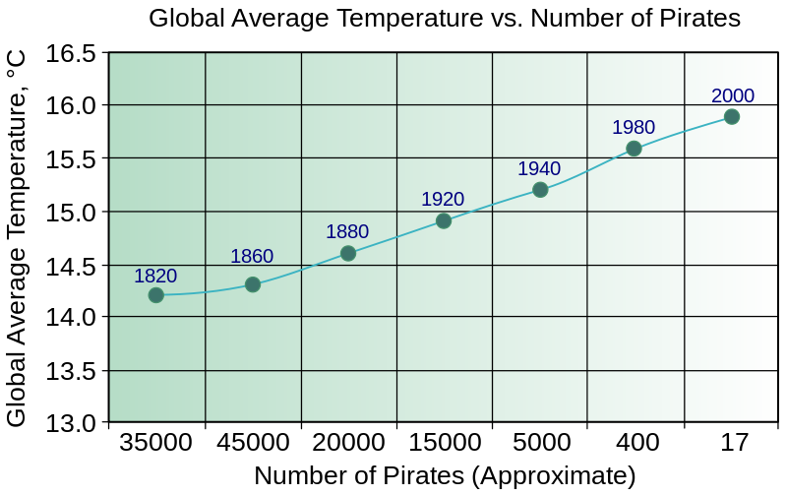
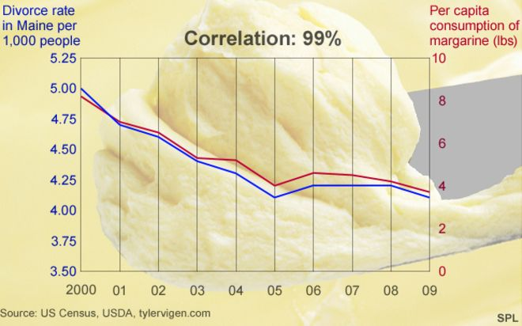
Correlation and Causality
Eliminating Pirates Causes Global Warming?
Eating Less Margarine Reduces Divorce?
Solution: Scientific Measurement Methods
Experimental Data – Randomization such as A/B Testing
Observational Data – Statistical adjustment
19

Slide 20
Common Causality Related Questions in Business
Price: Would a price reduction generate enough demand to be profitable? How low is optimal?
Promotion: How to optimize marketing and advertising campaigns?
Place: Where to open new stores/branches? How should they look?
Product: Would an improvement in product feature be valuable to customers?
Process: Would a change in quality monitoring process be able to reduce defect and cost effective?
People: Would a modified employee education program be beneficial?
20

Slide 21
Direct Marketing - Testing Combinations of Product/Marketing Features:
Hypothetical but Realistic
Treatment Combinations for a Banking Credit Card Email Campaign
Attributes
Re-mail
APR
Credit Limit $
Color of Font
Offer
Subject Line
yes
7.9%
2000
Blue
Incentive
Introducing...
Attribute
Levels
X
12.9%
no
X
5000
X
Black
X
No Incentive
X
Hi from XYZ Bank...
8000
Great value from...
12,000
Don’t miss...
Attribute Levels
2
2
4
2
2
4
256 possible offer combinations – A Full Factorial Design
From 256 to 32 cells
Fractional Factorial Design
Statistically
Reduced to
An 87.5% savings in # cells
21

Slide 22




Optimization Opportunities
Individual Characteristics
Channel
Message/Offer
Individuals
Best deal…
No risk free trial…
Lowest price ever…
Super benefits…
Unbeatable service…
Top performance…
Scientifically proven…
Lots of Possible Treatment Combinations
22

